Slide 1

EXAMINING
‘THE CHARTER SCHOOL MIRACLE’
What the Data Shows
• Research conducted and charts below prepared by Boston Public School parent John Lerner, based on Department of Education & BESE data. (Thanks to Bill Schechter and Katie Solomon for pulling the information together.)

Slide 2

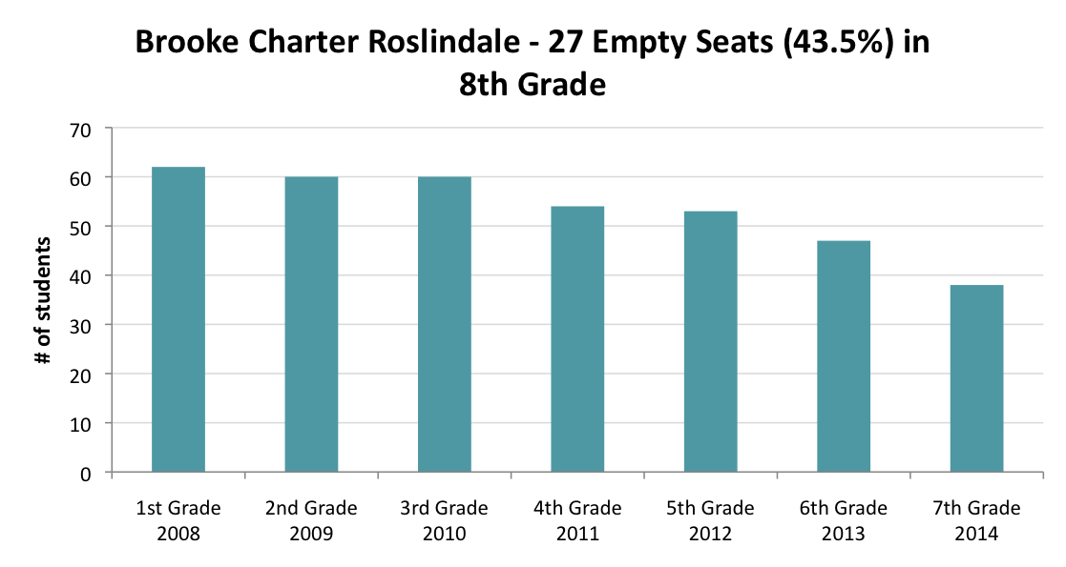
I: DECLINING ENROLLMENTS:
Where have all the students gone?
Brook Charter School
27 students disappeared from the Brooke Charter School over the course of 7 years. Where did they go and why?

Slide 3
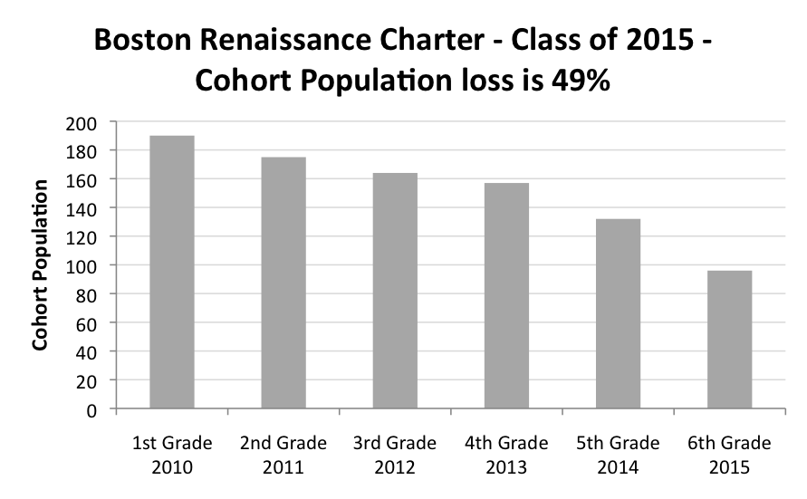
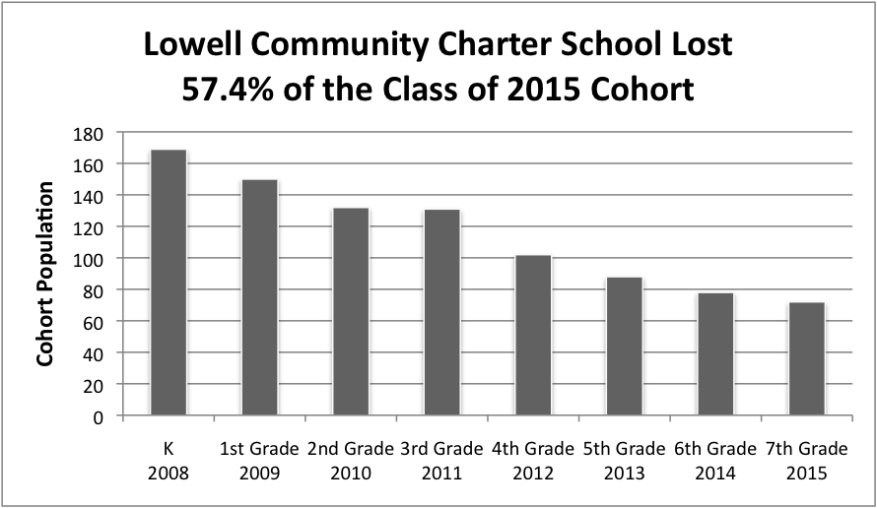
Boston Renaissance Charter
Almost half of students who started at Boston Renaissance Charter in 1st grade were gone by 6th grade.
Lowell Community Charter
57.4% of students who started at Lowell Community Charter in Kindergarten were gone by 7th grade.

Slide 4
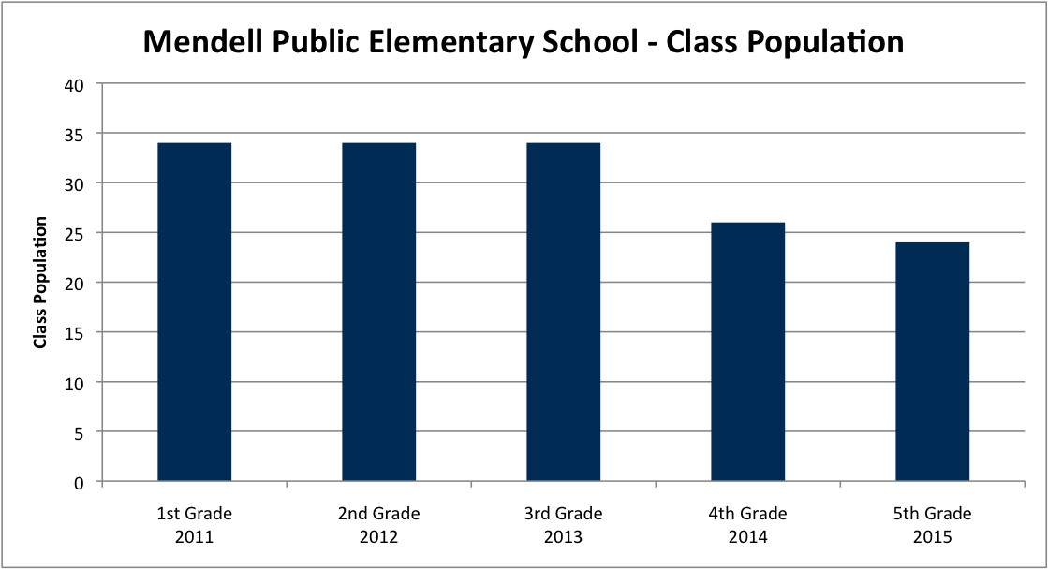
Mendell Public Elementary School in Roxbury
While many Charters have declining enrollments from year to year, the loss of even a few students to charters adversely affects the funding of public schools. Eight students transferring to charters cost the Mendell Elementary School about $60,000, the equivalent of one teacher’s annual salary.

Slide 5
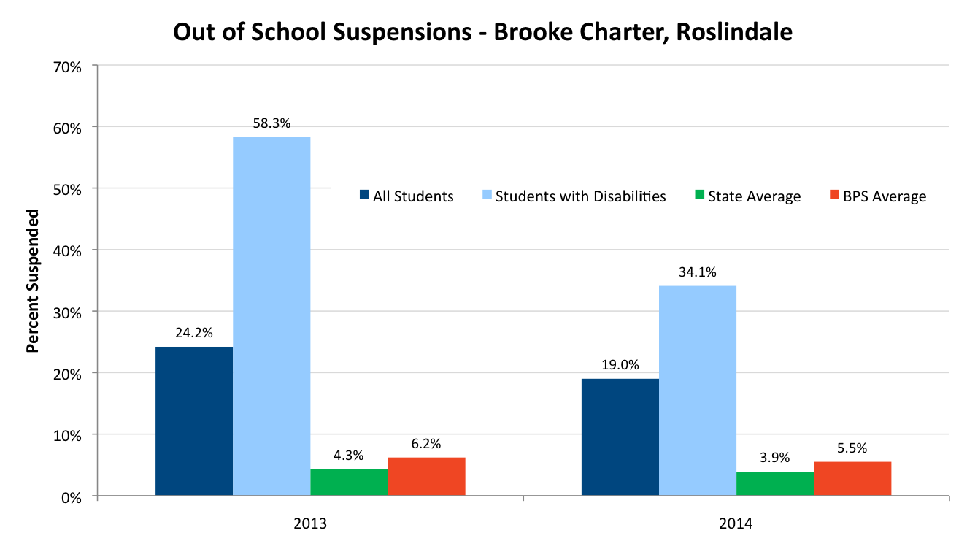
II: SUSPENSIONS: The Prelude to Charter School Enrollment Attrition
Brooke Charter School
The average percentage of out-of-school suspensions in Massachusetts in 2013 was 4.3%. Brooke’s out-of- school suspension rate was 24.2% -- 58.3% for students with disabilities.

Slide 6
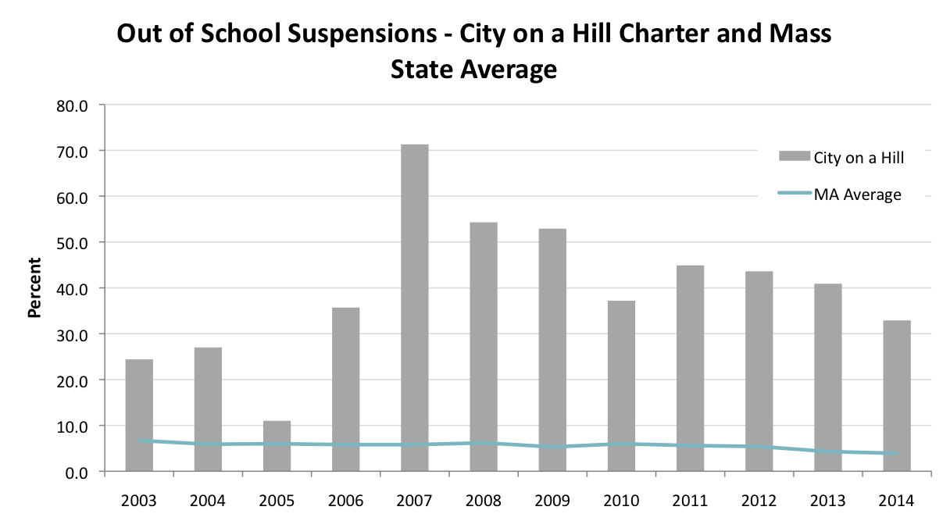
City on a Hill Charter
The percent of out-of-school suspensions at City on a Hill Charter, Circuit St., Roxbury, was higher (often by a significant amount) than the Massachusetts average every year from 2003 to 2014.

Slide 7
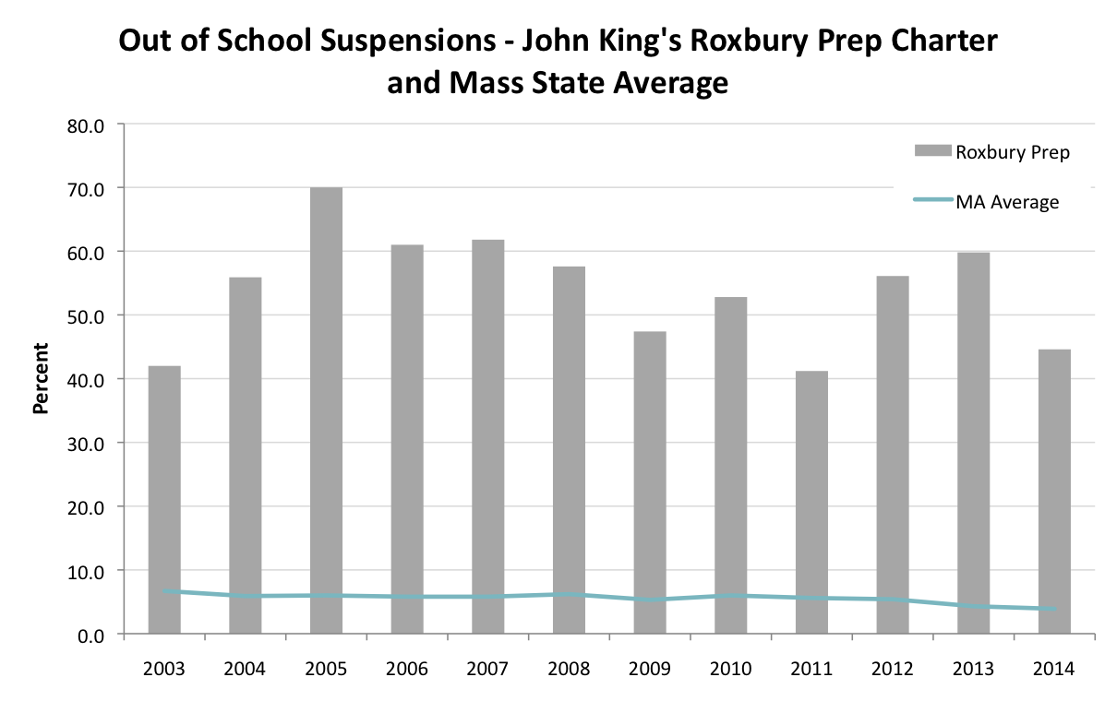
Roxbury Preparatory Charter
What happens to those students on the days that they aren’t allowed in school? What about their families? Why are students at charter schools getting suspended at such high rates?

Slide 8
III: THE IMPACT OF ATTRITION ON MCAS SCORES
As less capable or less compliant students are pushed out and counseled out, or as parents pull their children out, many charter class enrollments get smaller from year to year. This dynamic contributes to a higher average MCAS score among the smaller cohort that remains.

Slide 9
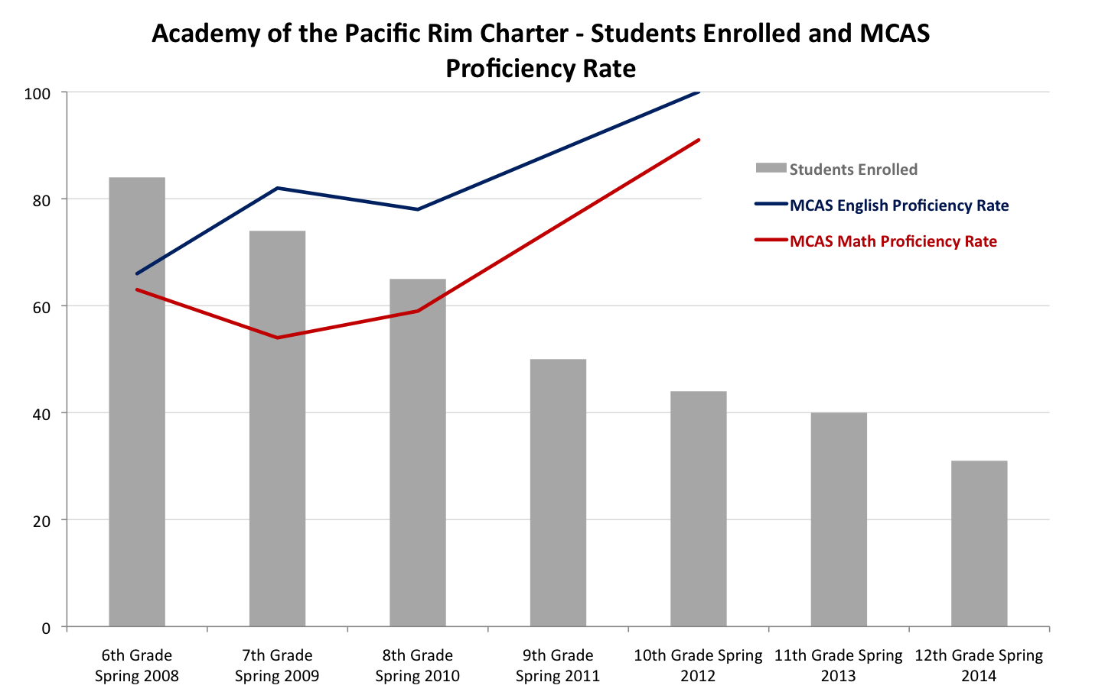
Academy of the Pacific Rim Charter
Over a 6-year period, 63% of the population of students left the Academy of the Pacific Rim Charter. As the student population dropped, the MCAS English and MCAS Math scores went up.

Slide 10
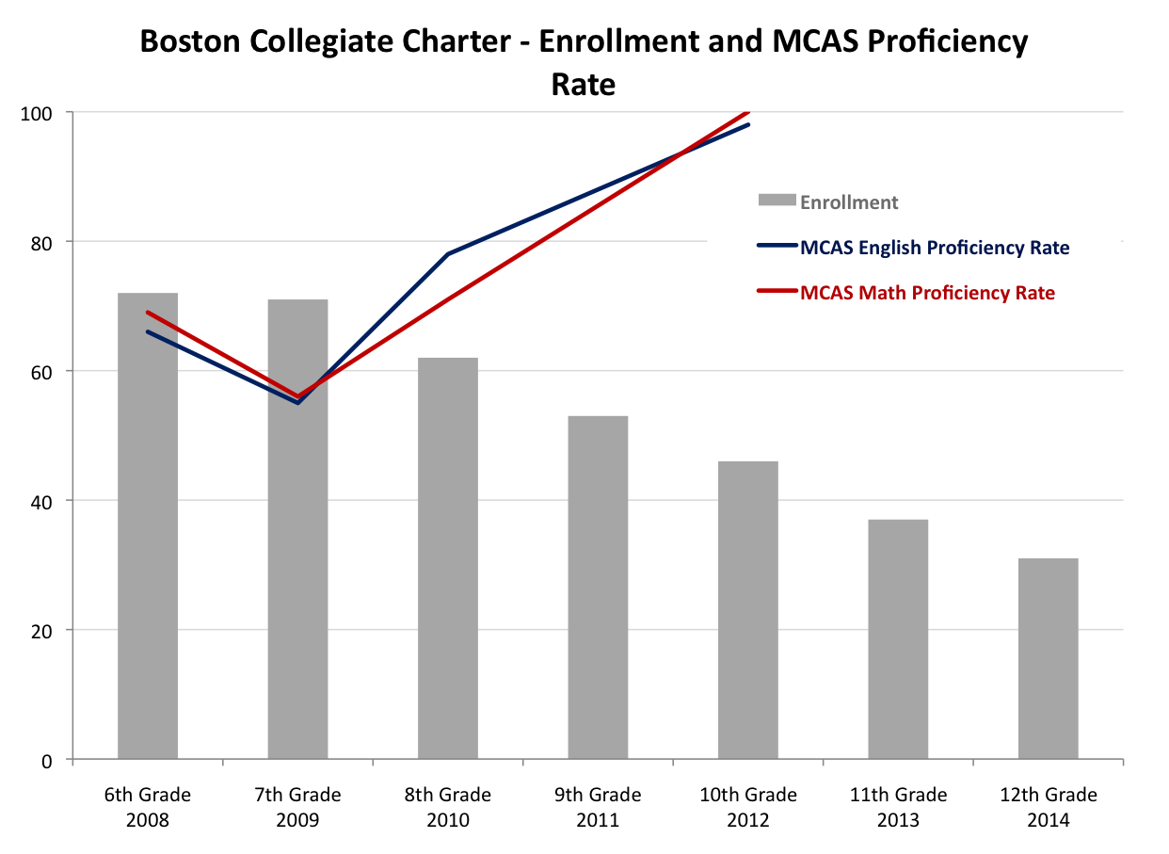
Boston Collegiate Charter Multi-Year Attrition
Over the course of 6 years, 57% of the population of students left Boston Collegiate Charter. As the student population dropped, the MCAS English
and MCAS Math scores went up.

Slide 11
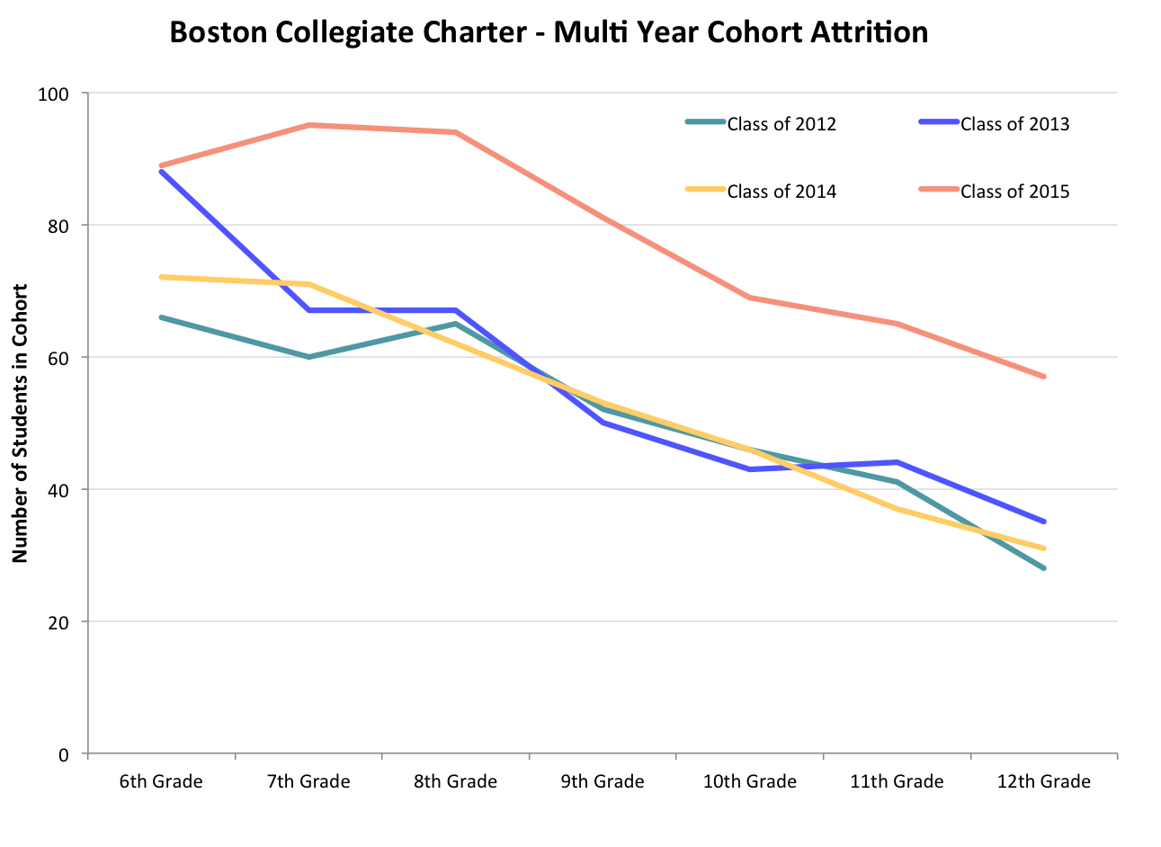

Slide 12
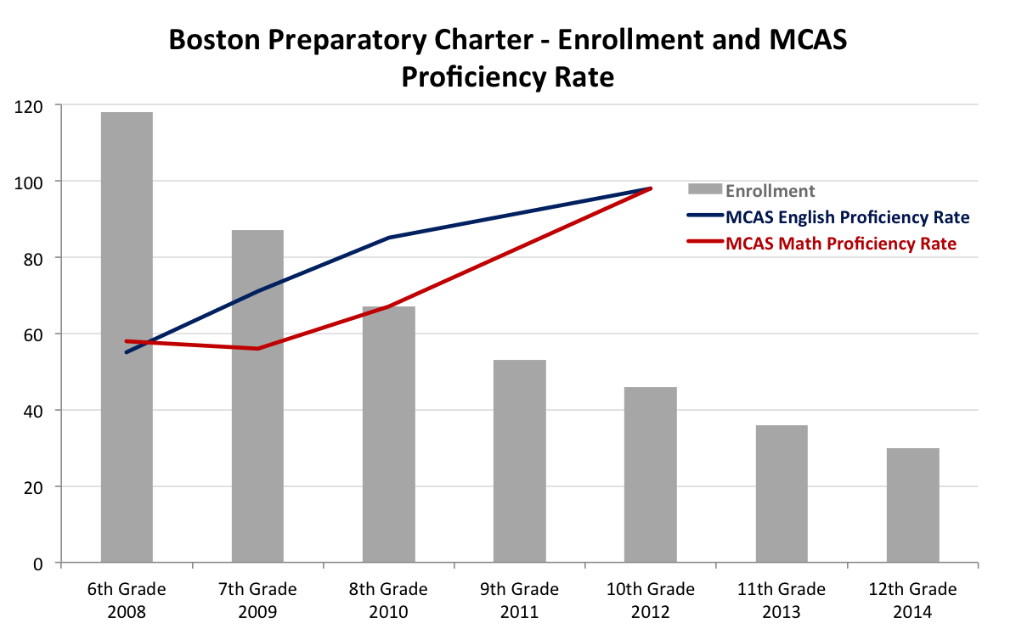
Boston Preparatory Charter
75% of the student population left Boston Preparatory Charter over a 6-year period.
As the student population dropped, the MCAS English and MCAS Math scores went up.

Slide 13
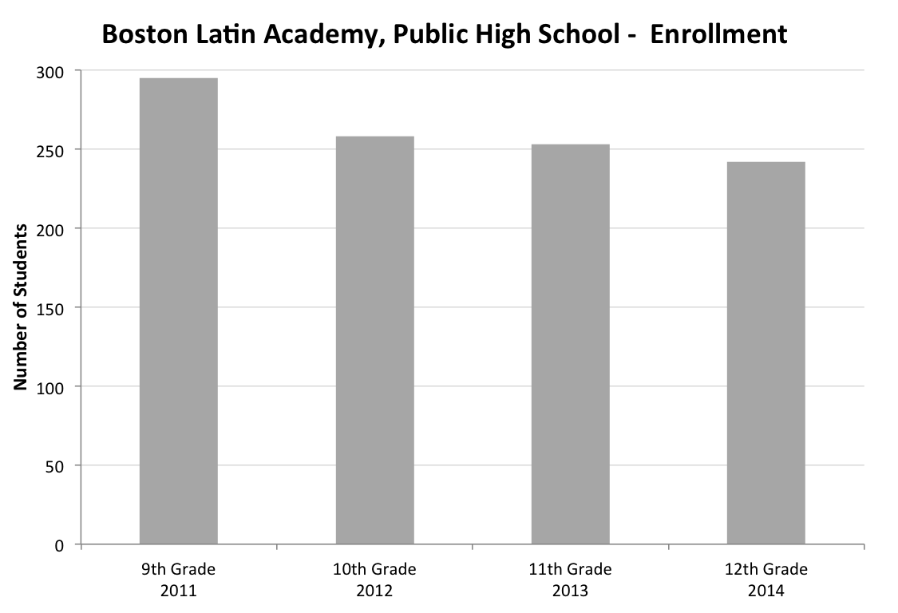
Boston Latin Academy
The average yearly population loss at Boston Latin Academy (a public high school) was only 6%.

Slide 14
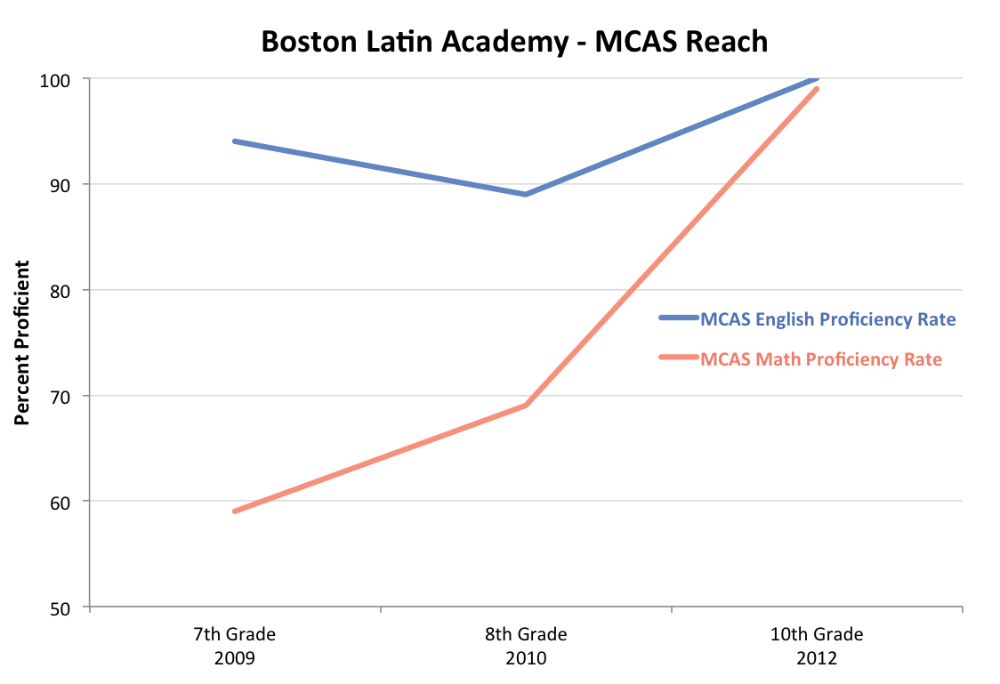
Even though only a small number of students left, their MCAS scores still reached 100% proficiency at 10th grade.

Slide 15
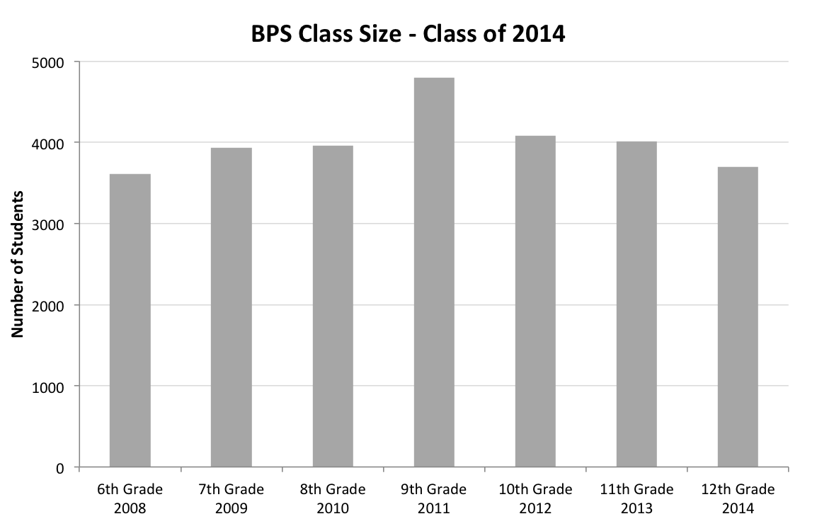
Boston Public School System
Over a 6-year period, the student population in Boston Public Schools increased by 2%. Despite the increase in students, MCAS proficiency rates increased steadily.
For the Class of 2014, 65% of 10th graders scored proficient or higher in math
and 73% scored proficient or higher on the ELA MCAS.

Slide 16
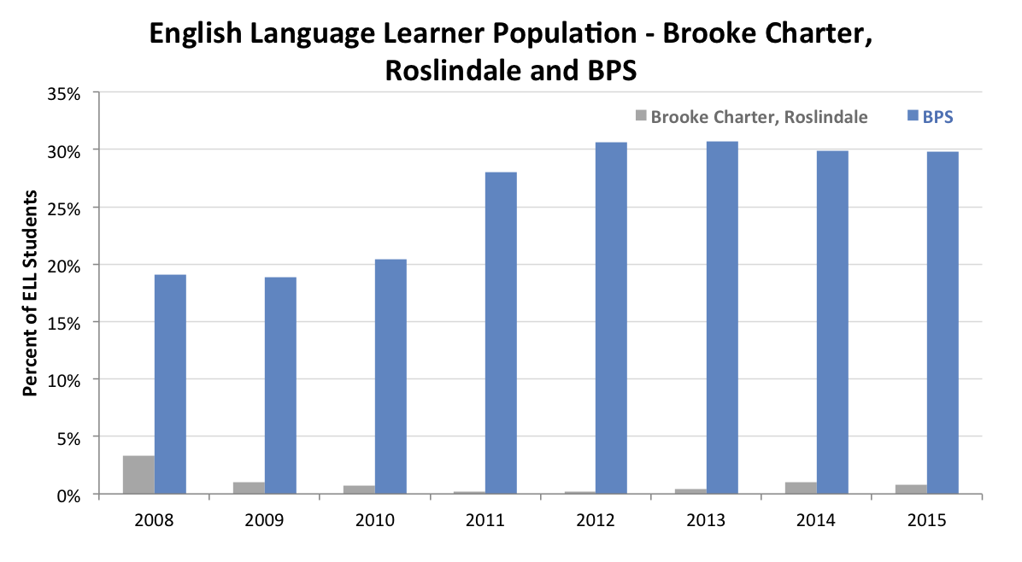
IV: PERCENTAGE OF ENGLISH LANGUAGE LEARNERS:
Public Schools vs. Charters
The percent of ELL students Boston Public Schools is significantly greater than at Brooke Charter Roslindale. Why are 20%-30% of students in Boston Public Schools ELL students while the percent of ELL students in Brooke Charter Roslindale never goes above 5%?

Slide 17
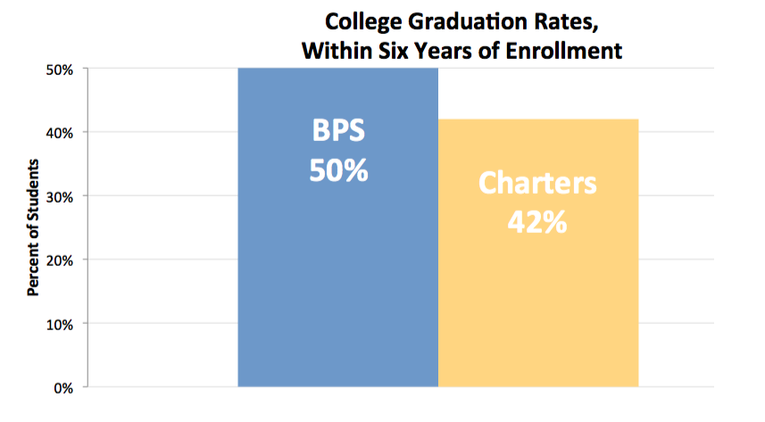
V: COLLEGE GRADUATION RATES:
Public School vs. Charter Students
*** January 2015, The Boston Opportunity Agenda: Fourth Annual Report Card.
http://www.tbf.org/tbf/81/~/media/5C473FE62FFB4914A6513139077E2D26.pdf

Slide 18
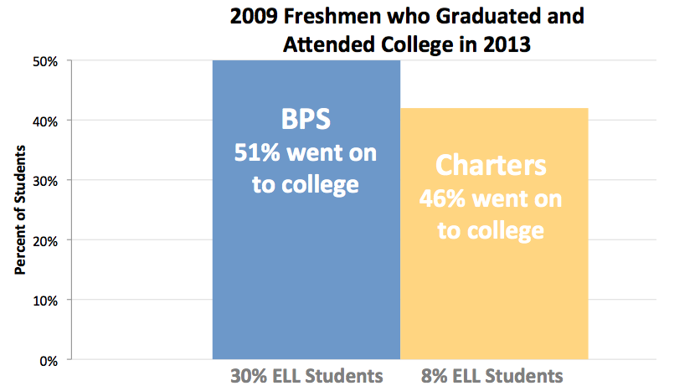
VI: COLLEGE ATTENDENCE RATES
FOR GRADUATES:
Public Schools vs. Charters
(with respective %s of ELL students given)

Slide 19
Works Cited
"School and District Profiles," Massachusetts Department of Elementary and Secondary Education (ESE), http://profiles.doe.mass.edu/.
“Fourth Annual Report Card,” The Boston Opportunity Agenda, January 2015, p. 17, http://www.tbf.org/tbf/81/~/media/5C473FE62FFB4914A6513139077E2D26.pdf.

Slide 20
Additional charts illustrating who charters serve, and their financial impact on the public system, can be found in the 2015 publication of the Massachusetts Association of School Committees (MASC): “Who Is Being Served.”
http://www.masc.org/images/news/2015/20151013_MASC_Charter-Schools_Who-Is-Being-Served_opt.pdf
For information about the inadequacies of state supervision of Charters and the “waiting list,” see the December 2015 report of State Auditor Suzanne Bump.
http://www.mass.gov/auditor/docs/audits/2014/201351533c.pdf

